Slide 1
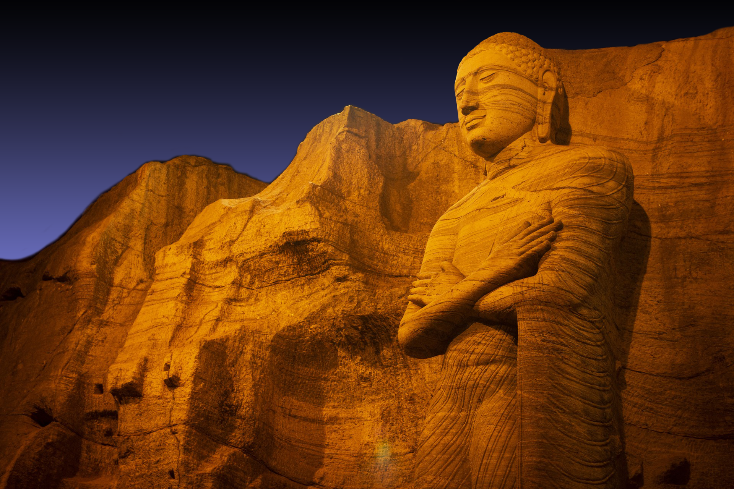

Slide 2
nqÿ mshdKka jykafia nqoaO;ajh i|yd l, m¾fhaIkh

Slide 3
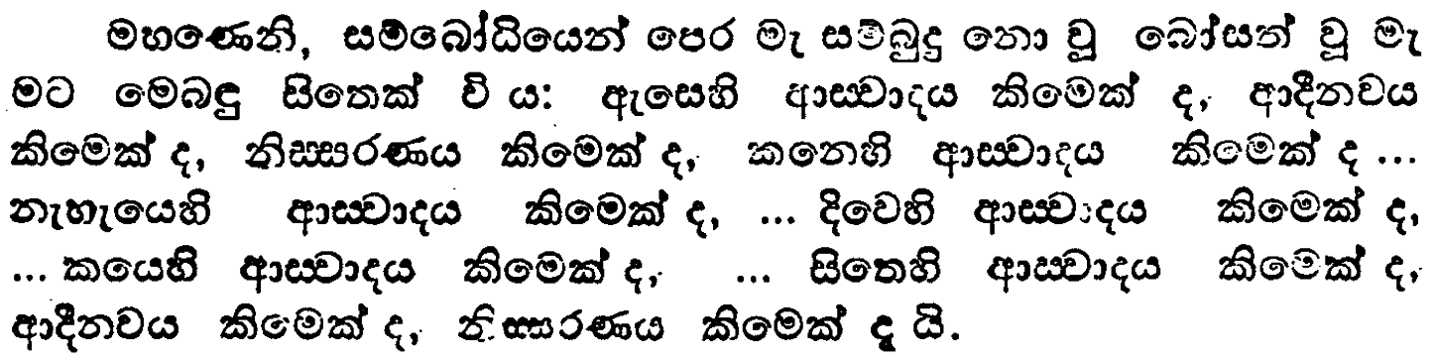
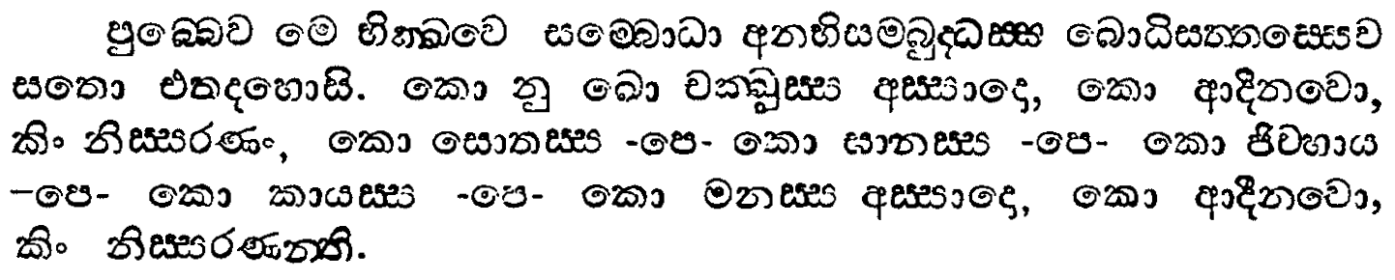
ix.ks. 4
iïfndaO iQ;%h
msgqj( 15

Slide 4
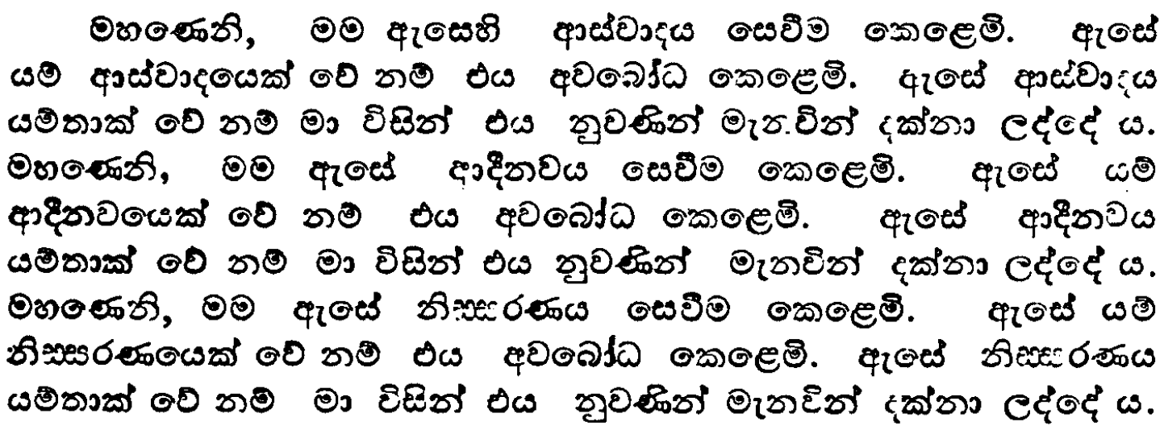
ix.ks. 4
wiaido mßfhaik iQ;%h
msgqj( 19

Slide 5
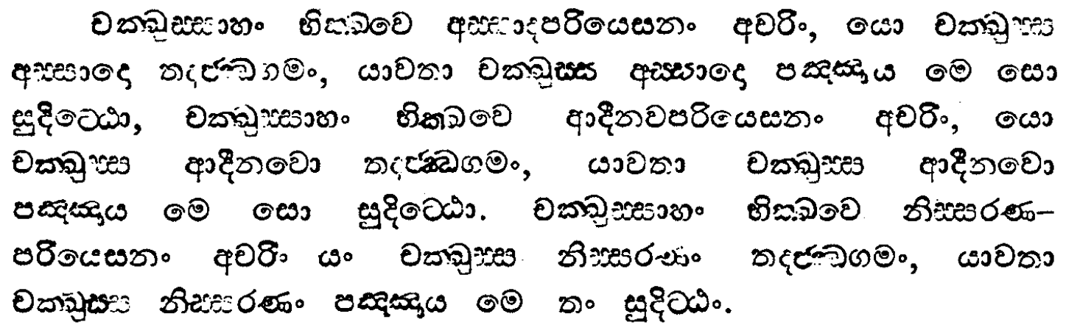
ix.ks. 4
wiaido mßfhaik iQ;%h
msgqj( 18

Slide 6
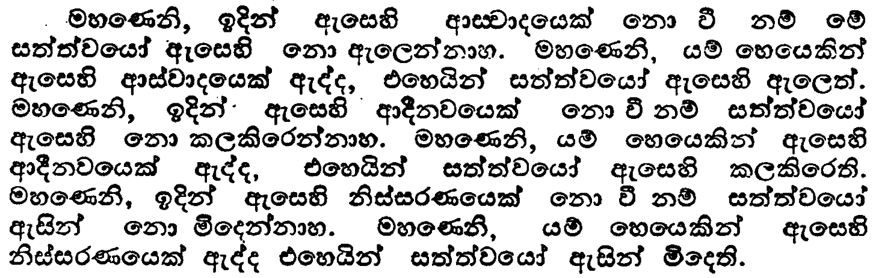
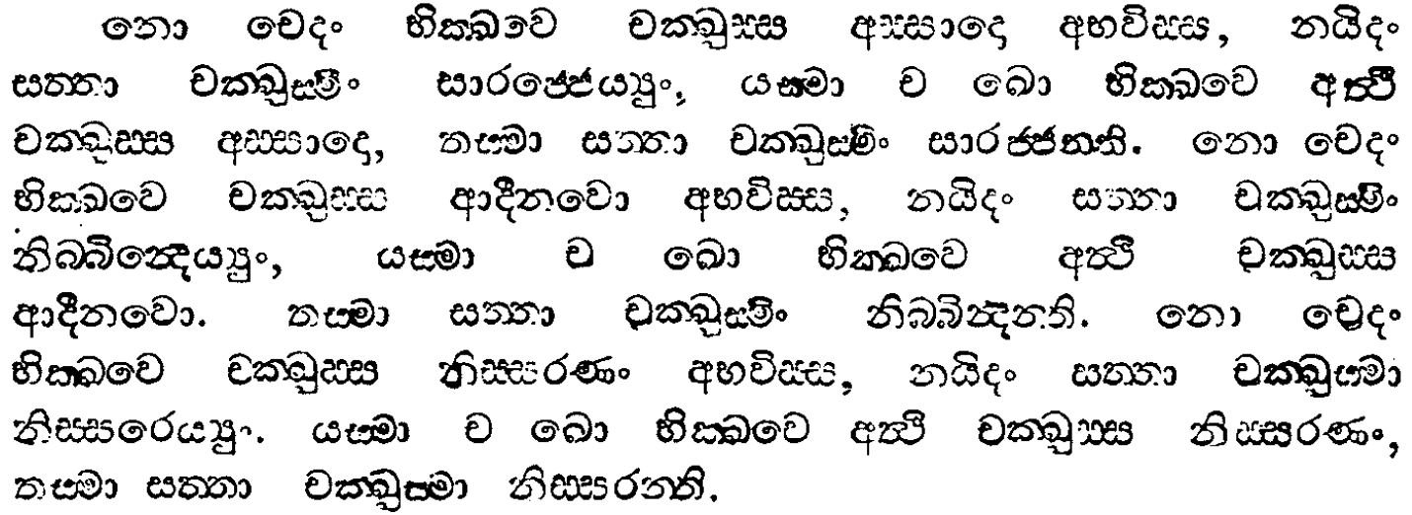
ix.ks. 4
fkd fp wiaido iQ;%h
msgqj( 21/0

Slide 7
;:d.; idikfha Y%uK flfkl= ùu i|yd oek.; hq;= oyï lreKq

Slide 8
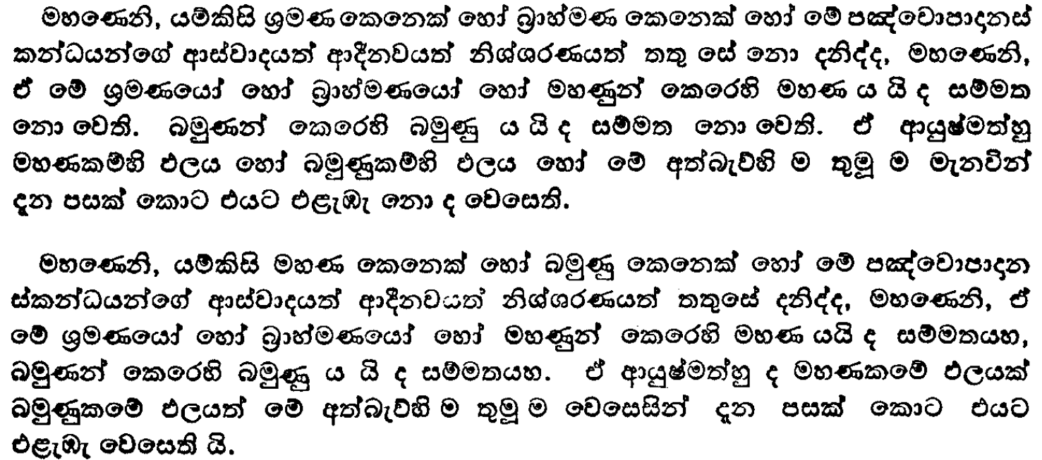
ix.ks. 3
iuK iQ;%h
msgqj( 279

Slide 9
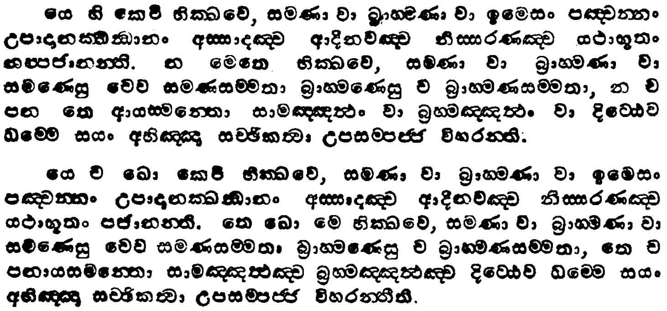
ix.ks. 3
iuK iQ;%h
msgqj( 278

Slide 10
fida;dmkak ùu i|yd oek.; hq;= oyï lreKq

Slide 11
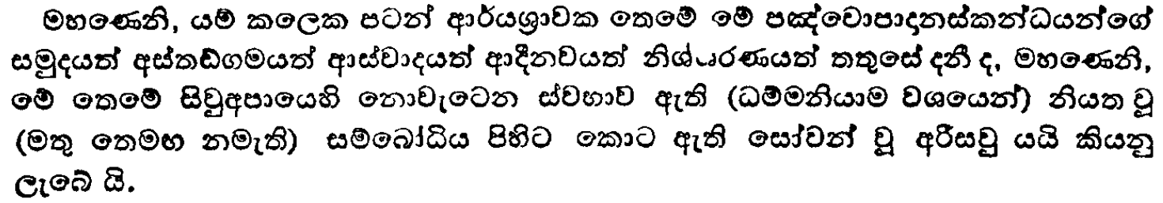
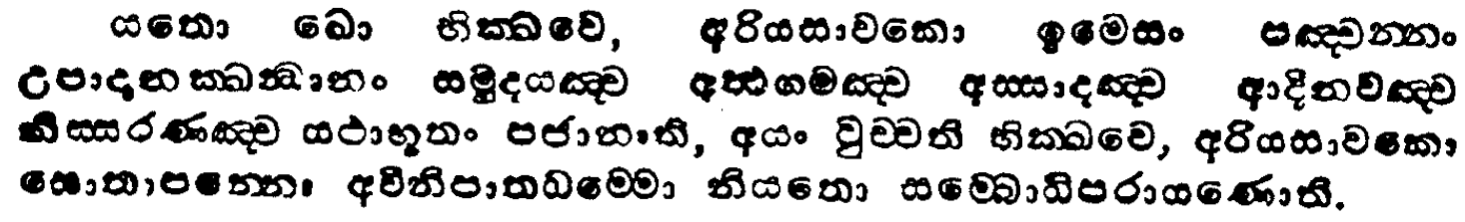
ix.ks. 3
fida;dmkak iQ;%h
msgqj( 278/9

Slide 12
;:d.; idikfha n%yau pßhdj i|yd oek.; hq;= oyï lreKq

Slide 13
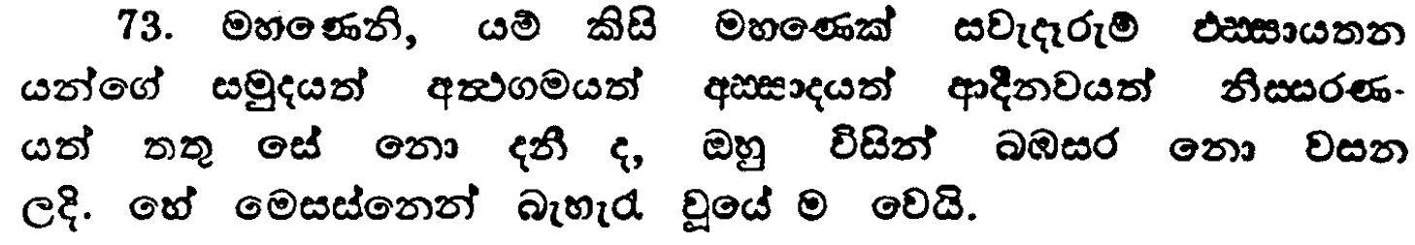
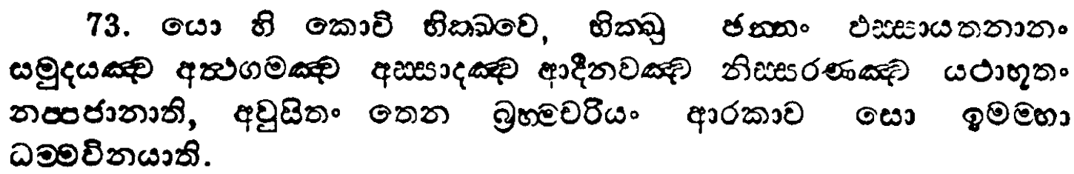
ix.ks. 4
;;sh PMiaidh;k iQ;%h
msgqj( 99/8

Slide 14
;:d.; idikfha
iu: - úmiaikd hkq l=ulao ?

Slide 15
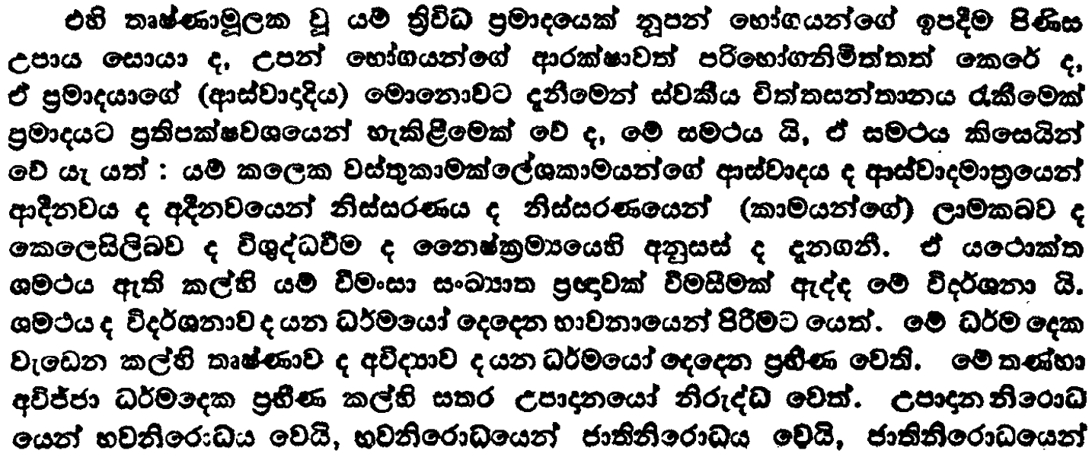
l=.ks.
fk;a;sm%lrKh
msgqj( 67

Slide 16
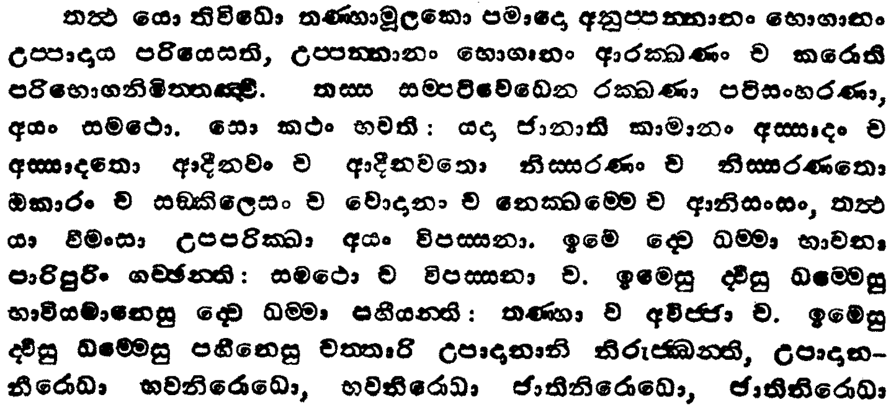
l=.ks.
fk;a;sm%lrKh
msgqj( 66

Slide 17
;:d.; idikfha
wúoHdj hkq l=ulao ?

Slide 18
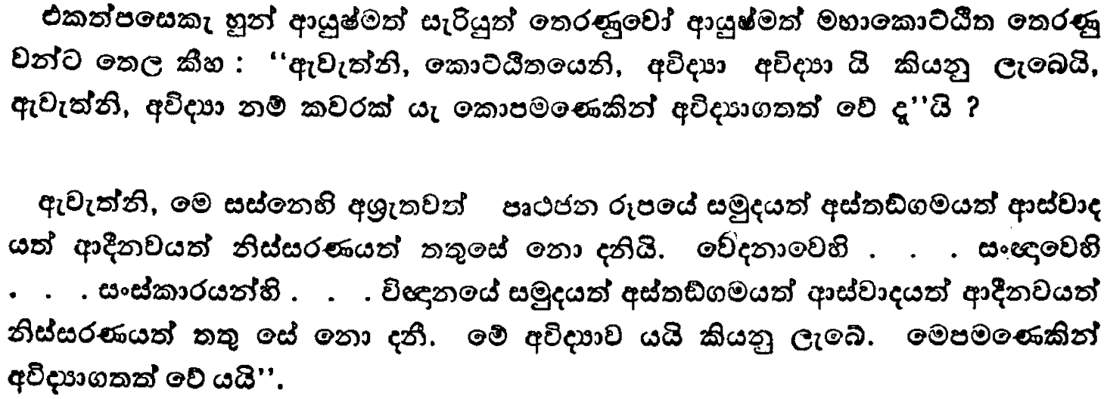
ix.ks. 3
ÿ;Sh fldÜÀ; iQ;%h
msgqj( 311

Slide 19
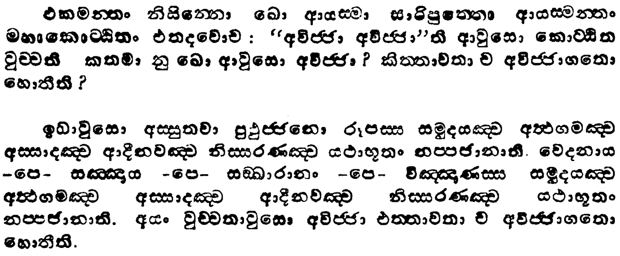
ix.ks. 3
ÿ;Sh fldÜÀ; iQ;%h
msgqj( 310

Slide 20
;:d.; idikfha
wiaidih iy mruiaidih
hkq l=ulao ?

Slide 21
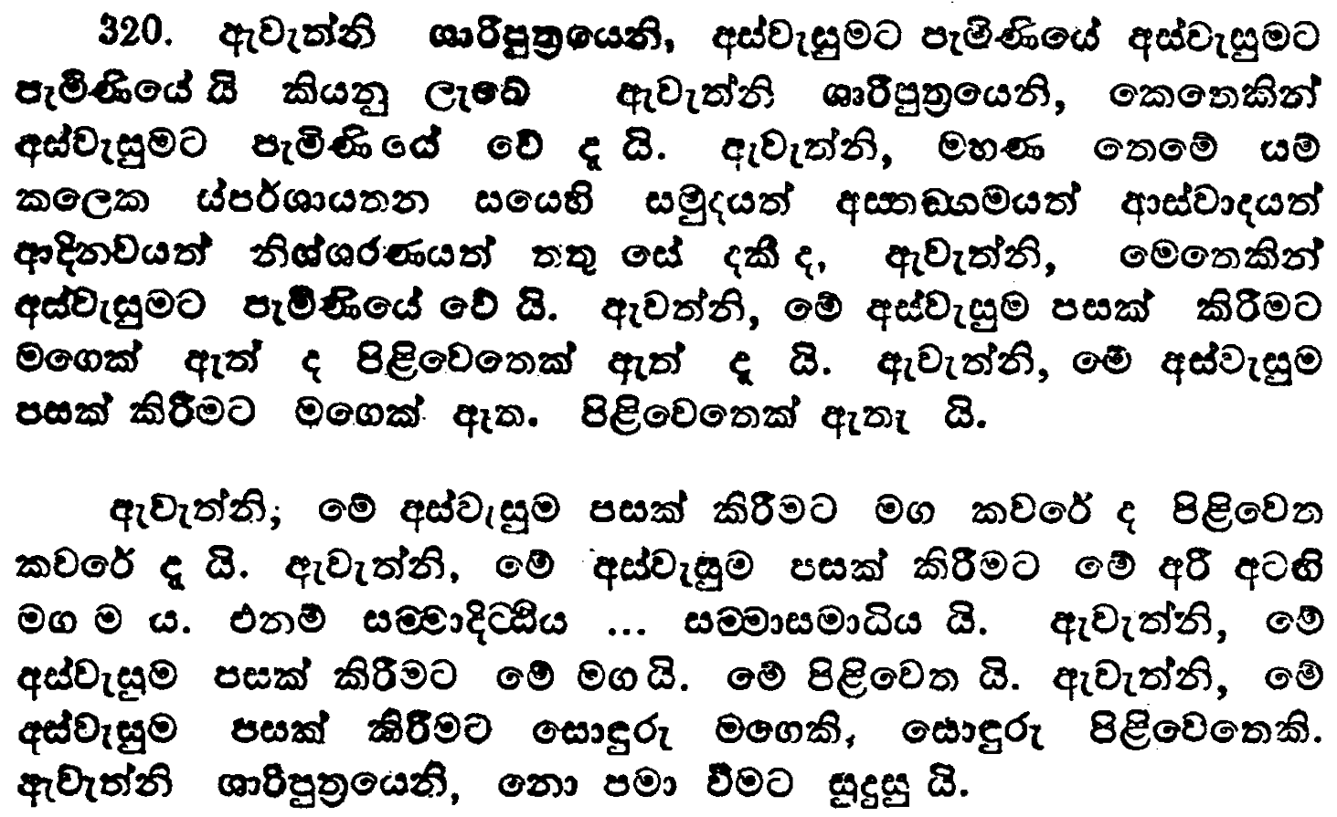
ix.ks. 4
wiaidi iQ;%h
msgqj( 479

Slide 22
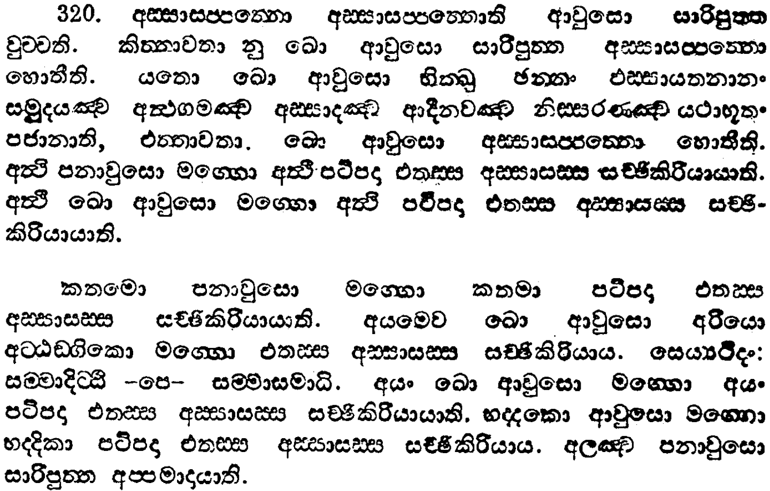
ix.ks. 4
wiaidi iQ;%h
msgqj( 478

Slide 23
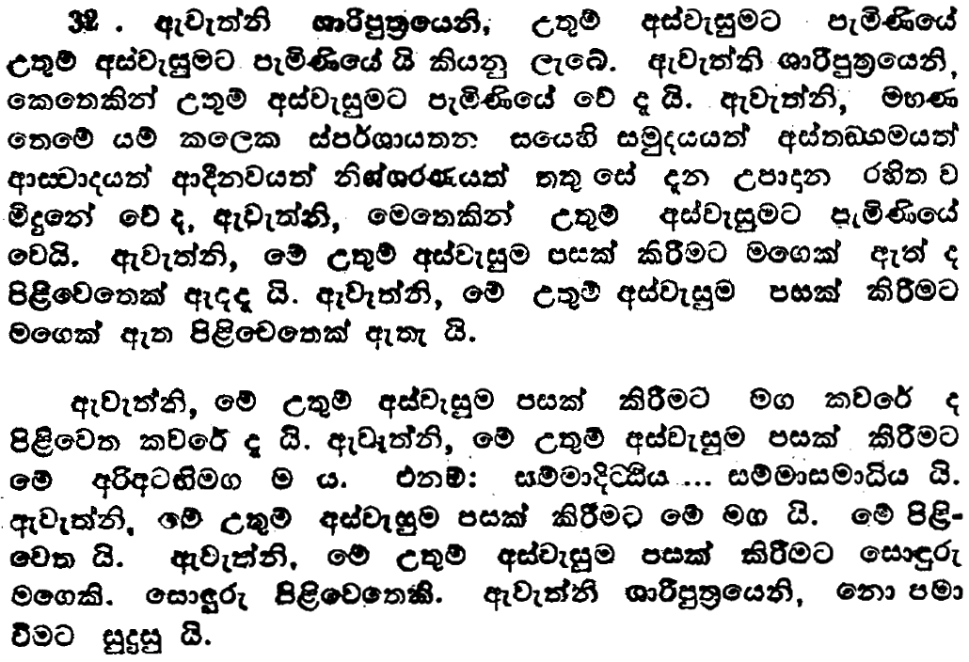
ix.ks. 4
mruiaidi iQ;%h
msgqj( 479

Slide 24
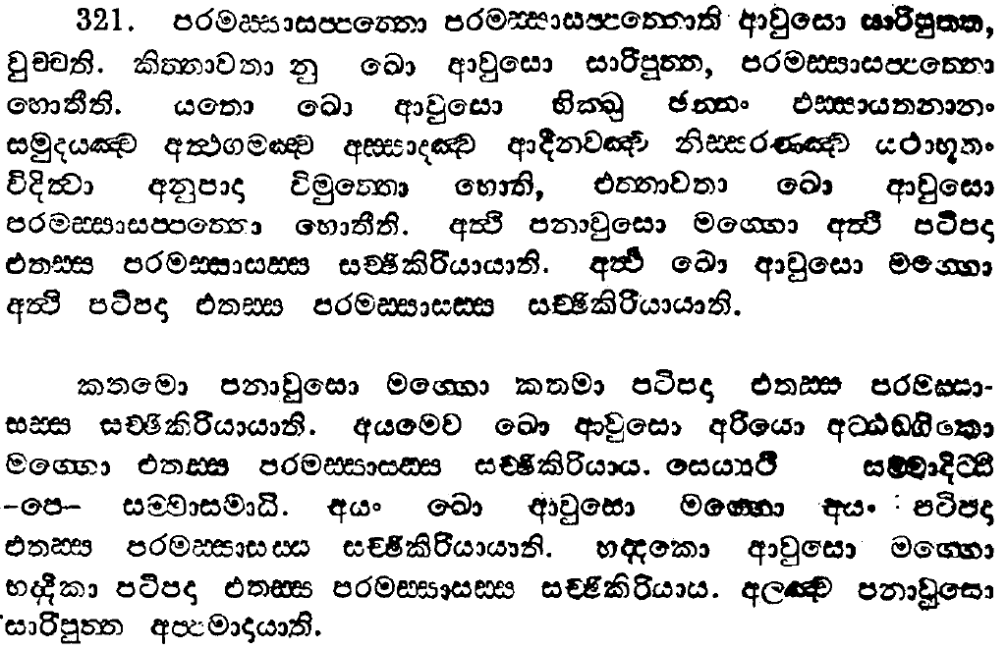
ix.ks. 4
mruiaidi iQ;%h
msgqj( 478

Slide 25
wiaidoh ms<sn|j wjfndaOhla we;af;a wd¾h Y%djlhkag
muKla nj

Slide 26
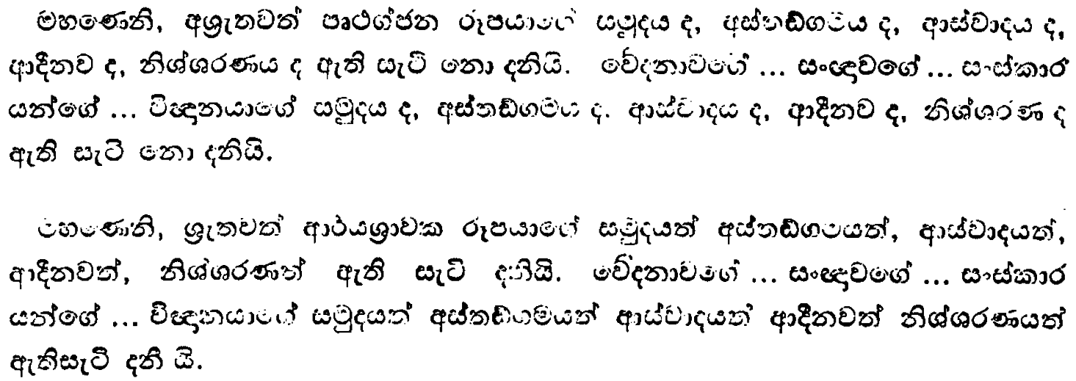
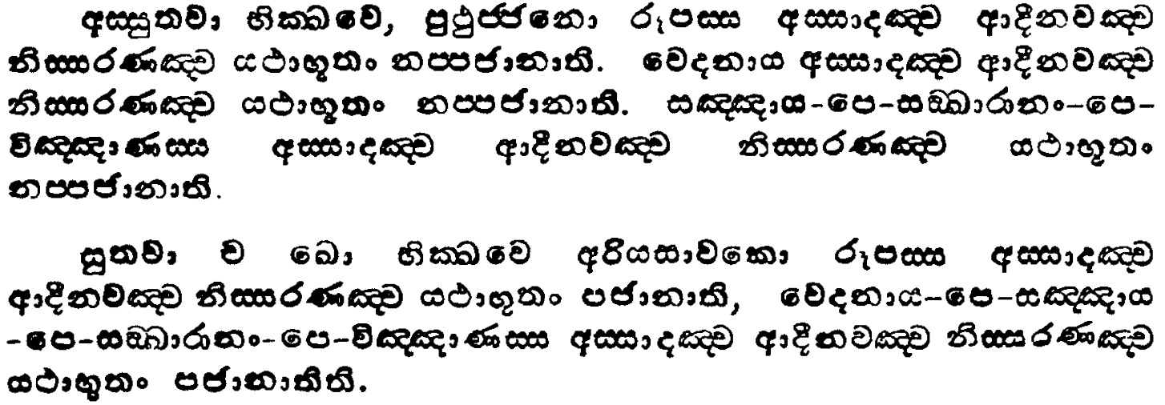
ix.ks. 3
wiaido iQ;%h
msgqj( 143/2

Slide 27
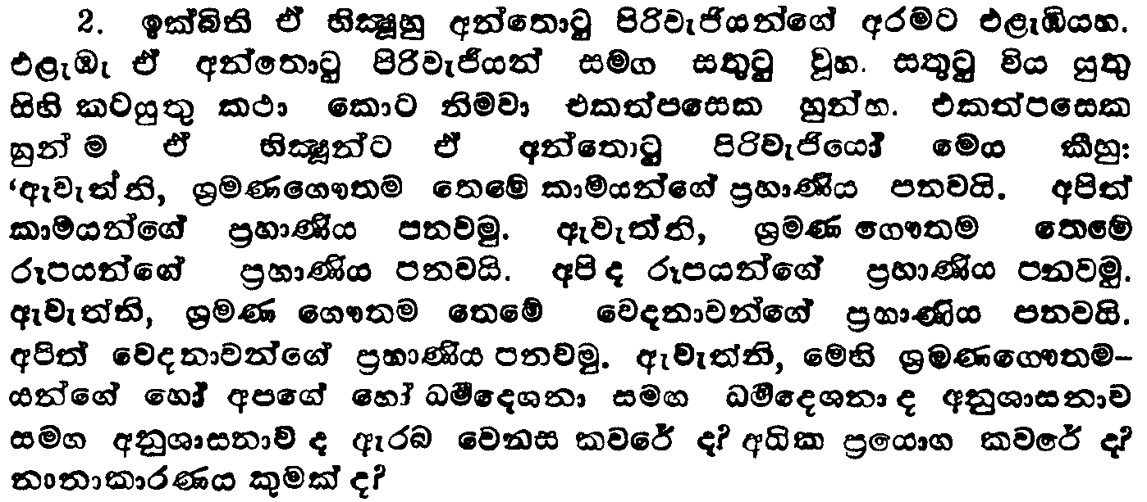
u.ks. 1
uydÿlaLlaLkaO iQ;%h
msgqj( 201

Slide 28
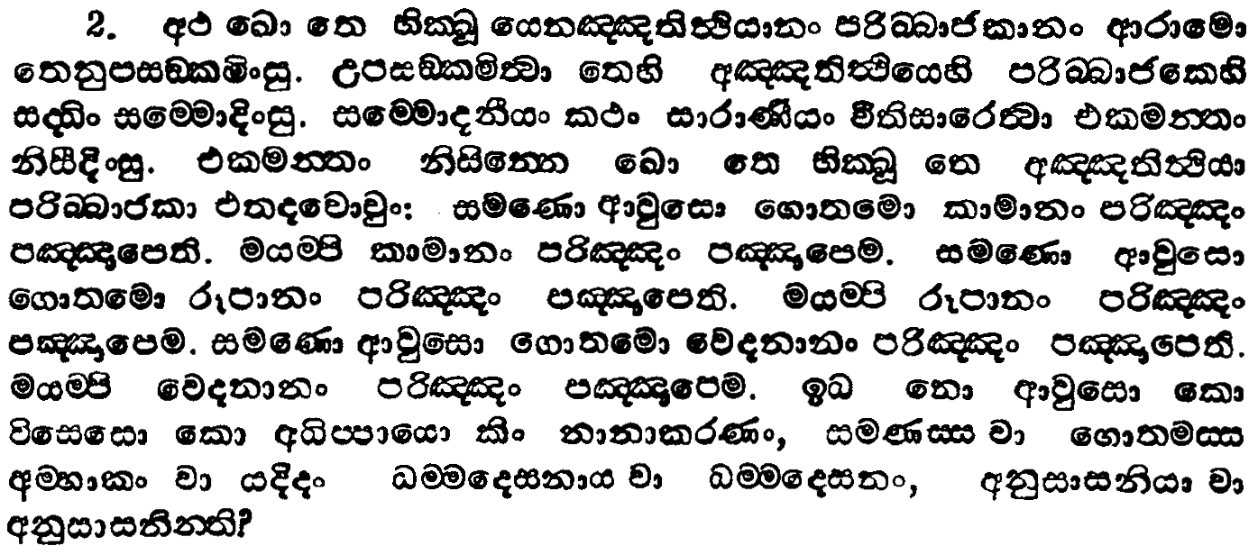
u.ks. 1
uydÿlaLlaLkaO iQ;%h
msgqj( 200

Slide 29
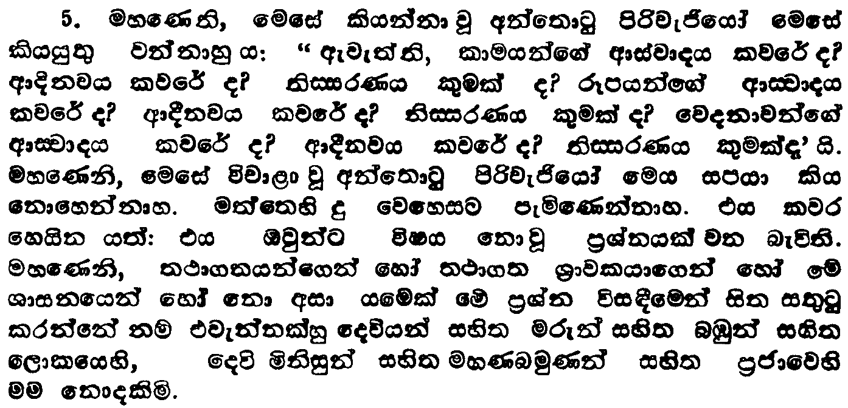
u.ks. 1
uydÿlaLlaLkaO iQ;%h
msgqj( 203

Slide 30
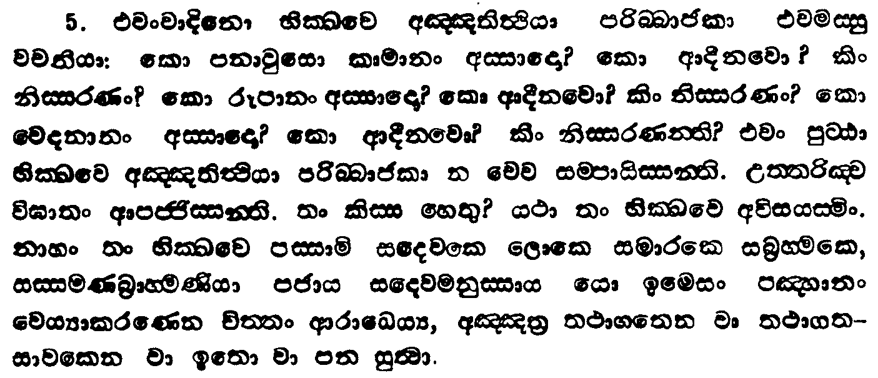
u.ks. 1
uydÿlaLlaLkaO iQ;%h
msgqj( 202

Slide 31
pß; ,laIK wkqj foaYkdj fjkiajk njg ;%smsgl idlaIs

Slide 32
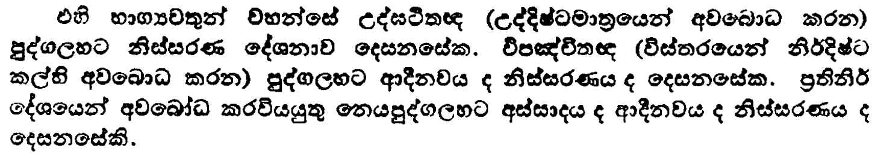
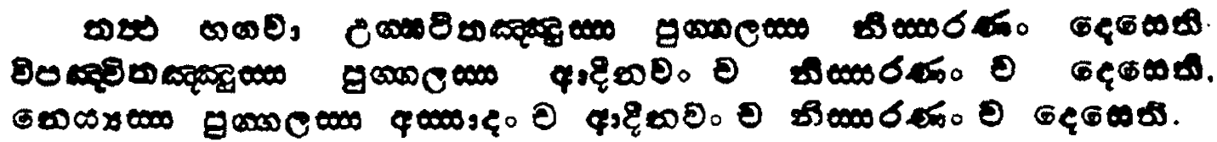
l=.ks.
fk;a;sm%lrKh
msgqj( 19/8

Slide 33
pß; ,laIK wkqj foaYkdj fjkia jk nj
Woa>á;{ |  |  | ksiairKh | ksjka oelSug jdikd we;s ;%sfya;=lhska
úm[aÑ;{ |  | wdoSkj | ksiairKh
fkhHmq.a., | wiaido | wdoSkj | ksiairKh
mo mru | mo j, jHdlrK rS;s yd mo mukla f;af¾' w¾: fkdf;afrk NdId úYdrohska jeks whhs' Tjqkag w¾:" O¾u" ksrela;s" máNdk kqjk my, fkdfõ' ni mukla wuqkd.;a w¾:fhka ny wuqKd nuqKd hk kduh mgnefoa' Tjqkag O¾uh foaYkd l, hq;af;a f,!lsl iq.;s u.h‘ |  |  | fuu w;aneõys ksjka oelSug jdikd ke;s wfya;=l iy ;%sfya;=l wh

Slide 34
Woa>á;{ úm[aÑ;{ fkhmq.a.,
mo mru hk y;r fldgigu wh;a fkdjk ;j;a wh isào ?
mdrñ;dj n,j;a jQ fndai;ajre jeks whhs

Slide 35
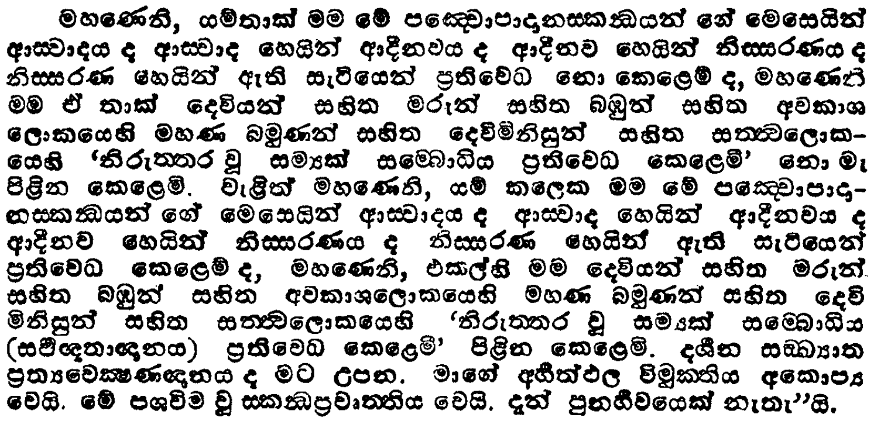
l=.ks.
máiïìodu.a.m%lrKh 2
msgqj( 31

Slide 36
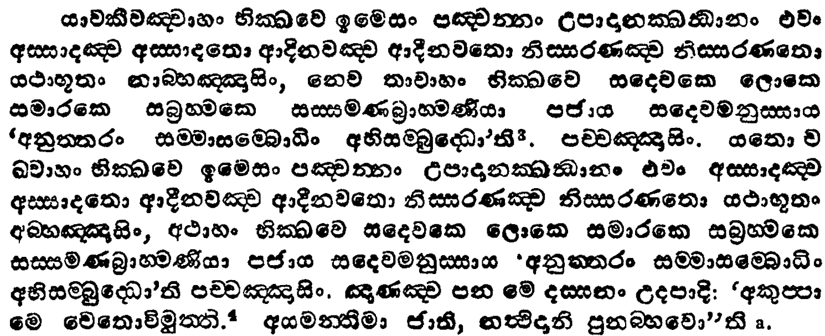
l=.ks.
máiïìodu.a.m%lrKh 2
msgqj( 30

Slide 37
;:d.; idikfha m%Odk;u b.ekaùu
wiaido
wdoSkj
ksiairKh

Slide 38


Slide 39
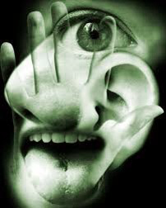
wfma ienE bÉP;ajh l=ulao ?
wei
lk
kdih
osj
YÍrh
uk
mskùu
fyj;a
wdiaidoh

Slide 40
wei
lk
kdih
osj
YÍrh
uk
rEm
Yío
.kaO
ri
fmdÜGín
Oïu

Slide 41
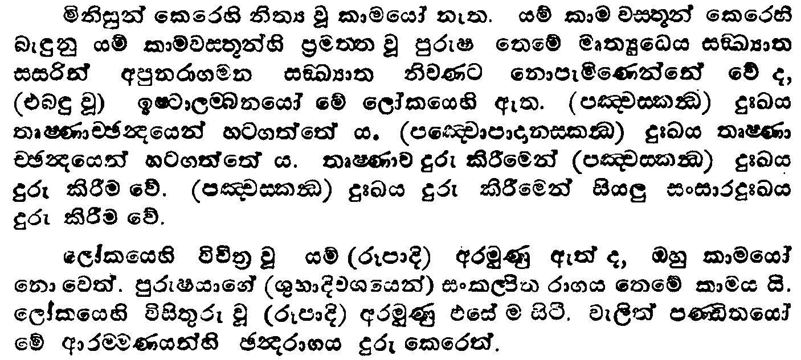
ix.ks. 1
kika;s iQ;%h
msgqj( 43

Slide 42
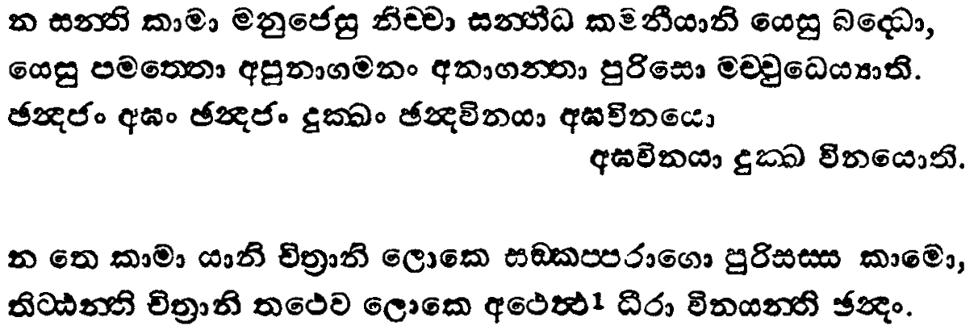
ix.ks. 1
kika;s iQ;%h
msgqj( 42

Slide 43
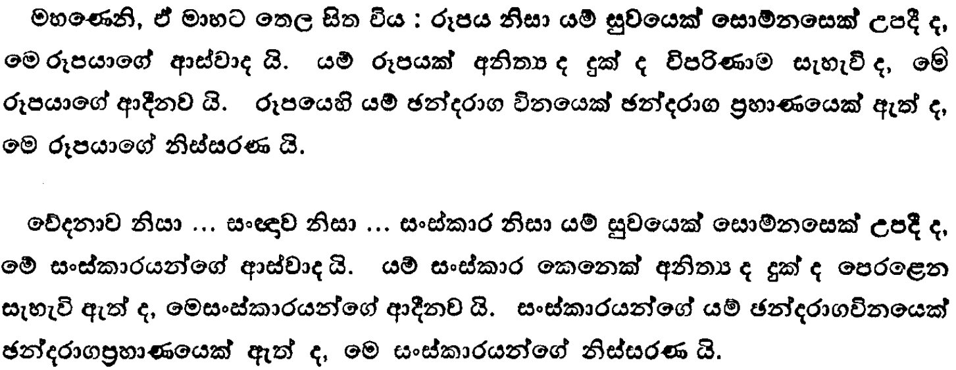
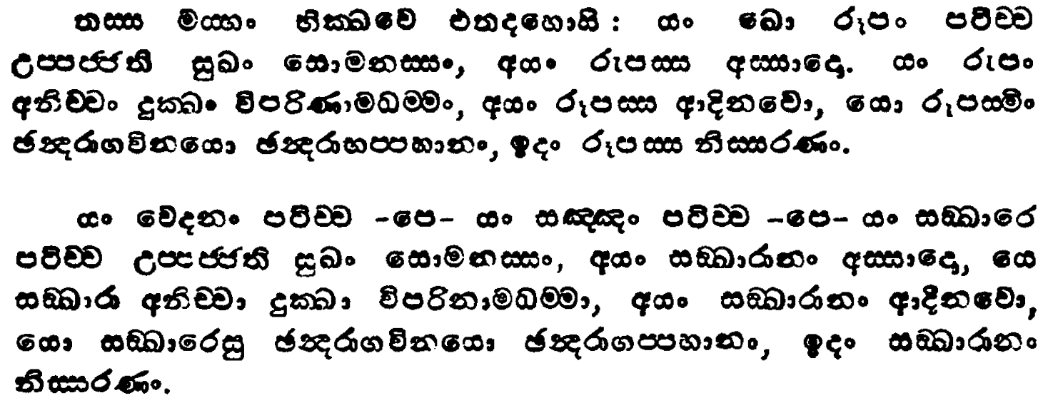
ix.ks. 3
mGu wiaido iQ;%h
msgqj( 51/0

Slide 44
iem fõokdj
iy
wiaidoh
hkq tlla fkdjk njg idlaIs

Slide 45
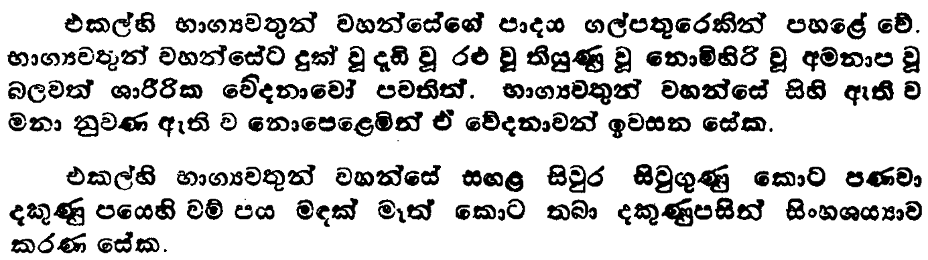
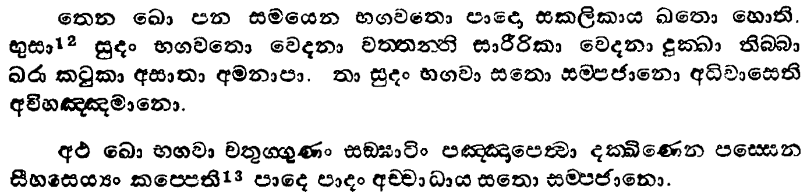
ix.ks. 1
il,sl iQ;%h
msgqj( 49/8

Slide 46
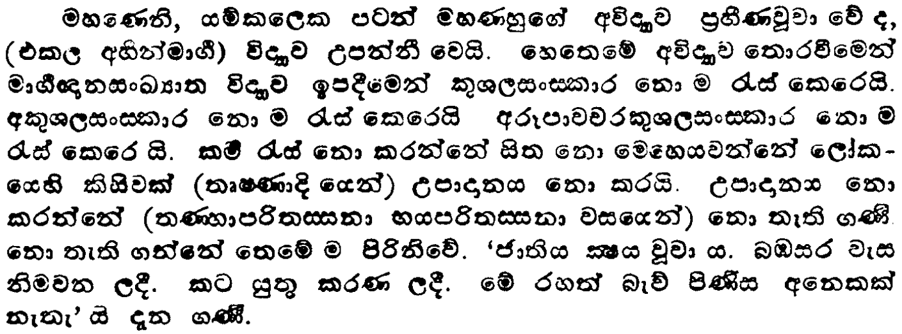
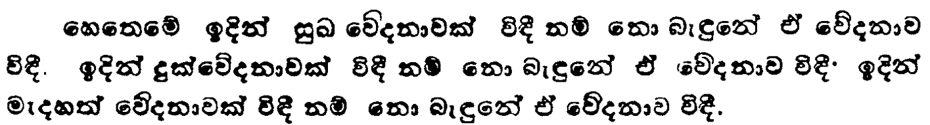
ix.ks. 2
mßúuxik iQ;%h
msgqj( 131

Slide 47
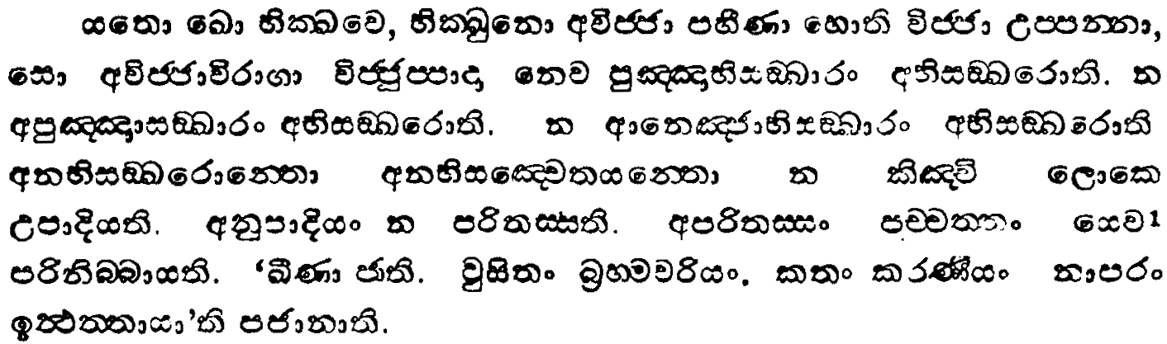
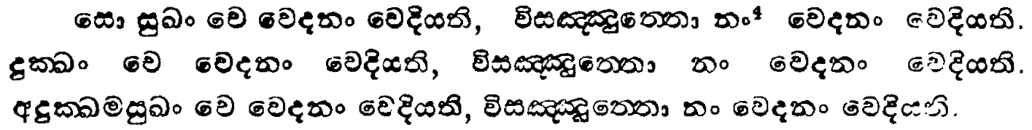
ix.ks. 2
mßúuxik iQ;%h
msgqj( 130

Slide 48
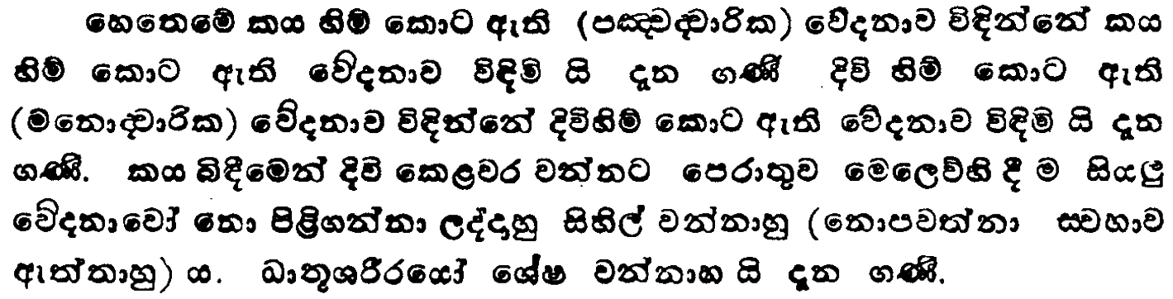
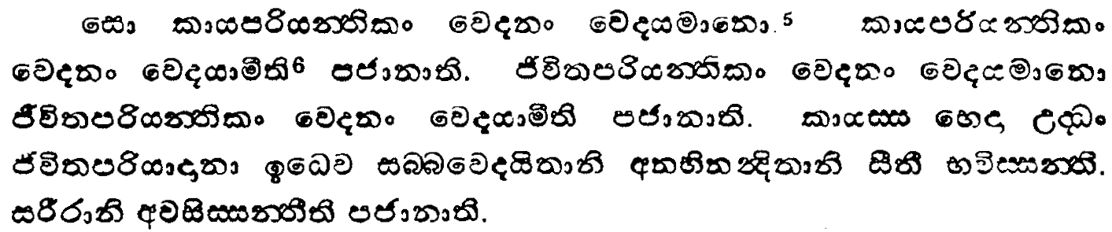
ix.ks. 2
mßúuxik iQ;%h
msgqj( 131/0

Slide 49
úmdl ÿla fõokdj fyda
iem fõokdj
m%ydKh l, fkdyel

Slide 50
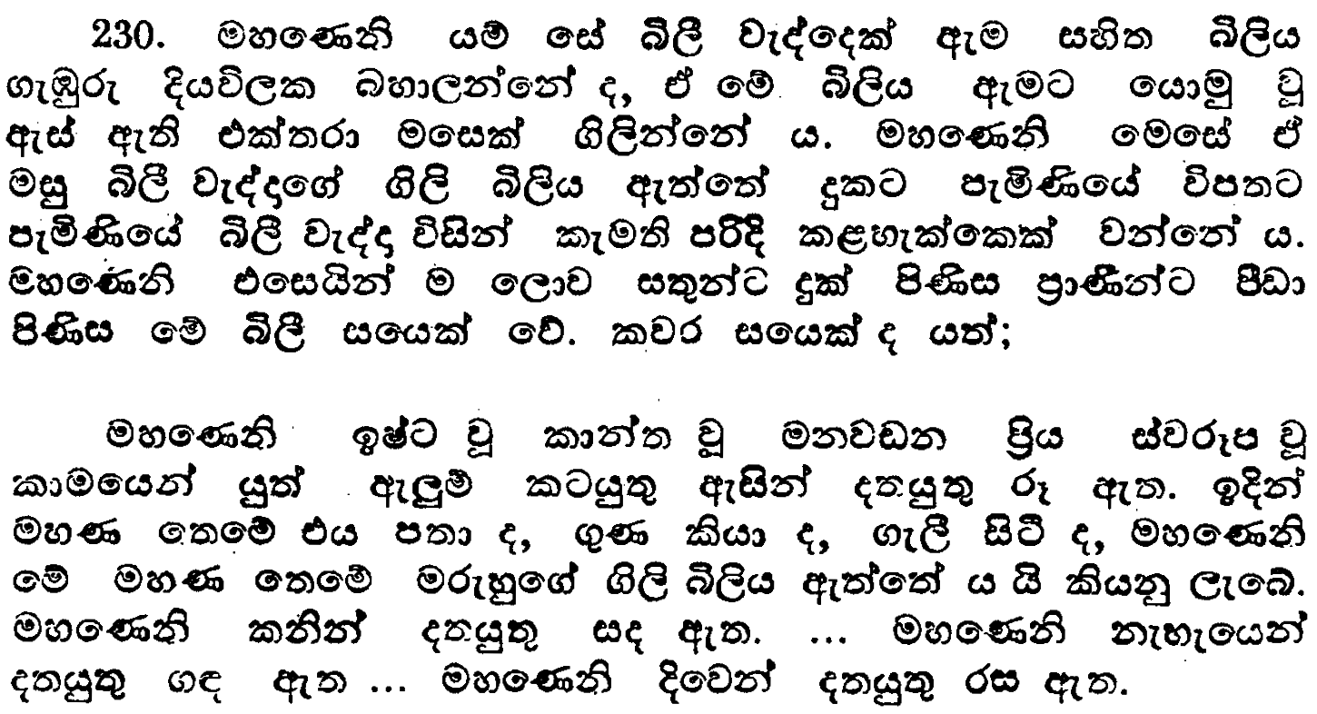

ix.ks. 4
nd,sisfldamu iQ;%h
msgqj( 315

Slide 51
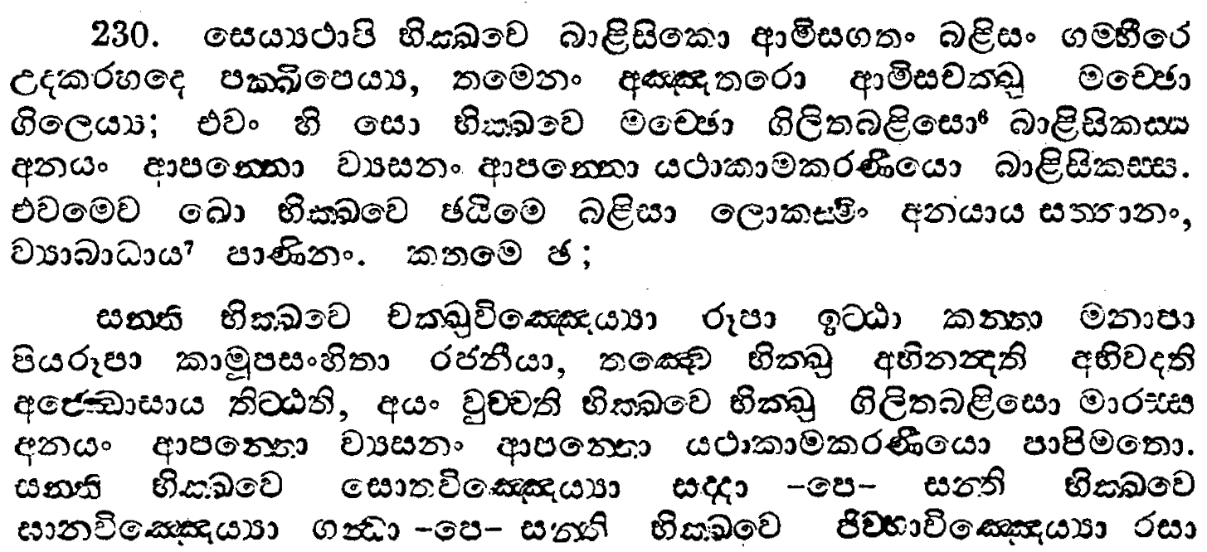
ix.ks. 4
nd,sisfldamu iQ;%h
msgqj( 314

Slide 52
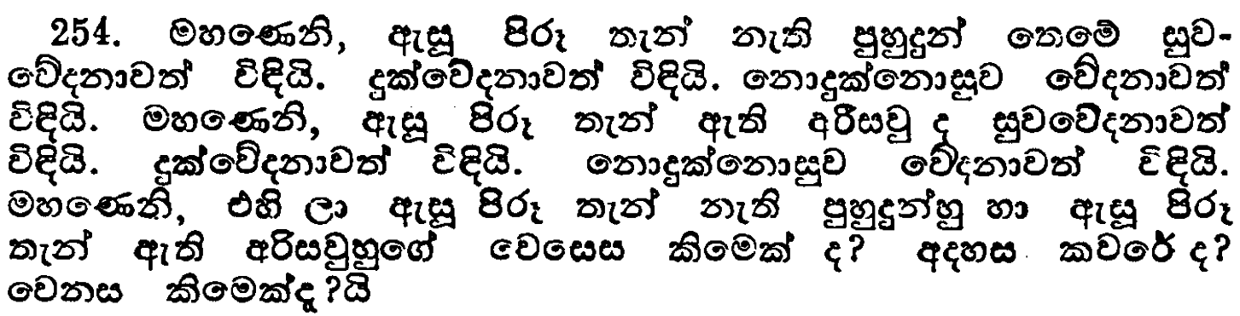
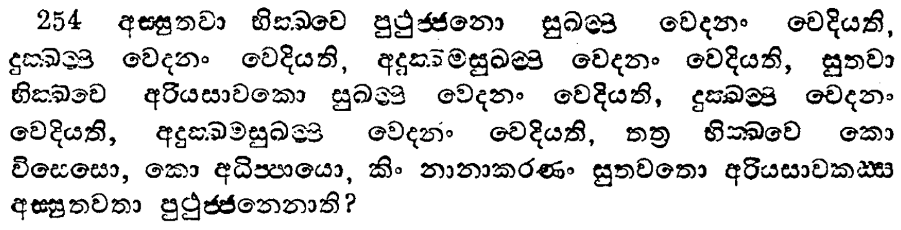
ix.ks. 4
i,a, iQ;%h
msgqj( 395/4

Slide 53
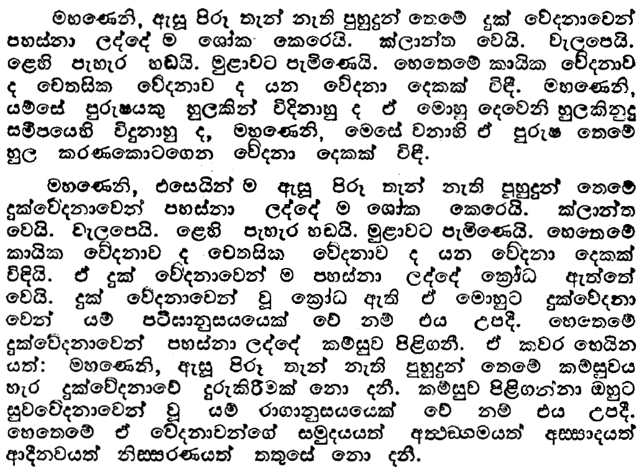
ix.ks. 4
i,a, iQ;%h
msgqj( 397

Slide 54
ix.ks. 4
i,a, iQ;%h
msgqj( 397

Slide 55
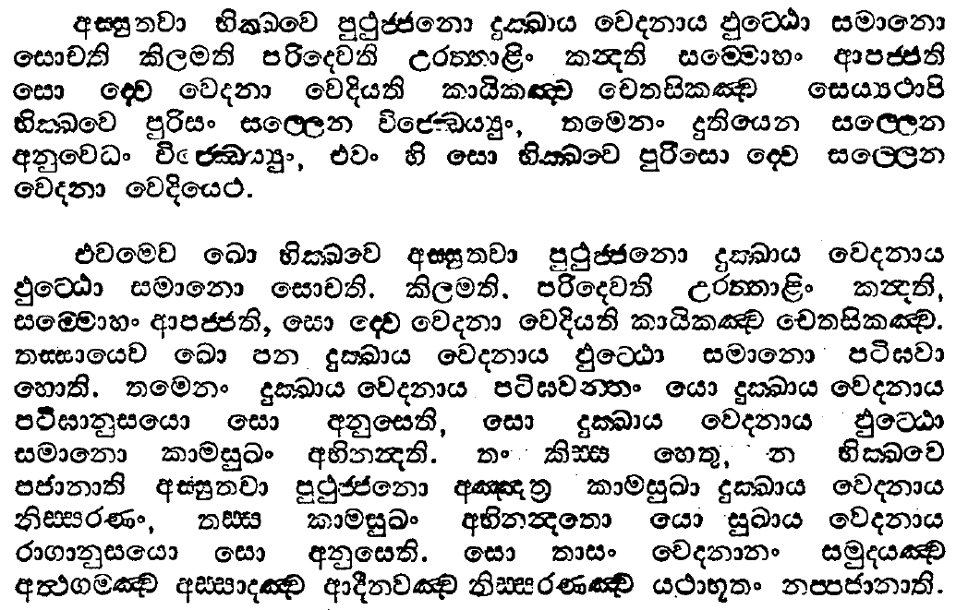
ix.ks. 4
i,a, iQ;%h
msgqj( 396

Slide 56

ix.ks. 4
i,a, iQ;%h
msgqj( 397

Slide 57

ix.ks. 4
i,a, iQ;%h
msgqj( 396

Slide 58
wiaiq;j;a mD;Êckhd fufkys lrk wdldrh

Slide 59

ix.ks. 2
ÿ;Sh wiaiq;jka; iQ;%h
msgqj( 151

Slide 60

ix.ks. 2
ÿ;Sh wiaiq;jka; iQ;%h
msgqj( 150

Slide 61


wx.ks. 6
.sßudkkao iQ;%h
msgqj( 200

Slide 62
ksudj

